Slide 1


Students Adaptability in Online Education
Shanila Ali.C.M

Slide 2

About Dataset
1.Content:
The target feature is Adaptivity level
The feature sets are: Gender , Age , Education Level , Institution Type , IT Student , Location in Town, Load-shedding ,
Financial Condition , Internet Type , Network Type , Class Duration , Self LMS , Device
2.Acknowledgement:
Original research paper:
Students' Adaptability Level Prediction in Online Education using Machine Learning Approaches
or DOI: 10.1109/ICCCNT51525.2021.9579741
Reference:
https://www.kaggle.com/datasets/mdmahmudulhasansuzan/students-adaptability-level-in- online-education

Slide 3
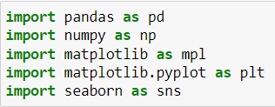

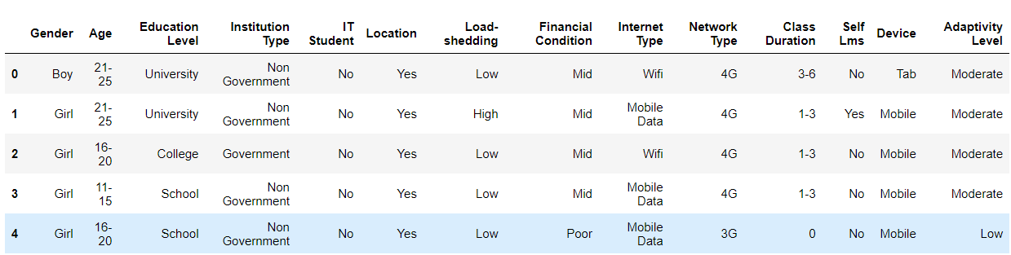
Importing Libraries and EDA

Slide 4
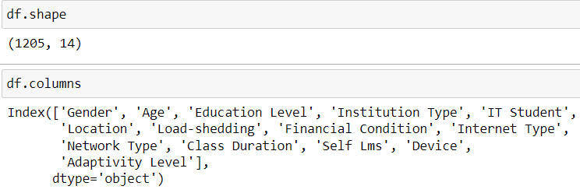
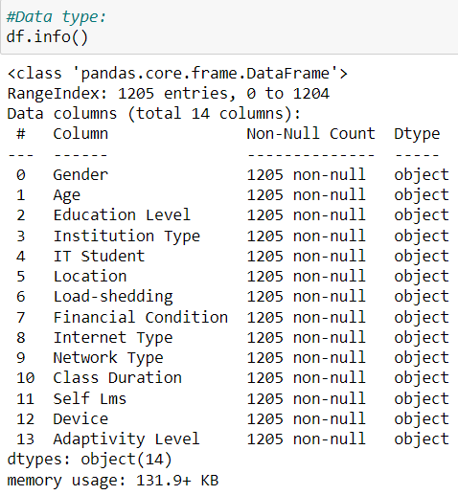
*The table has 1205 rows and 14 columns.
*All columns have a string data type, which indicates
that only categorical features are present.

Slide 5
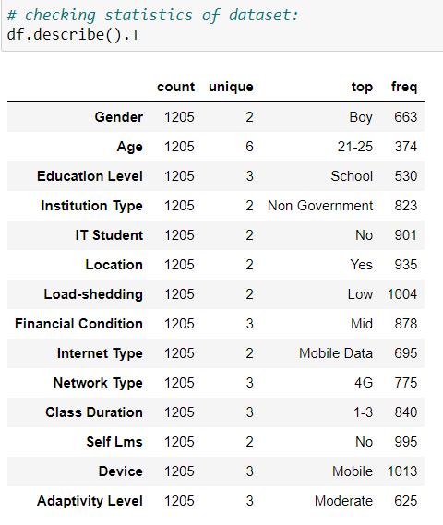
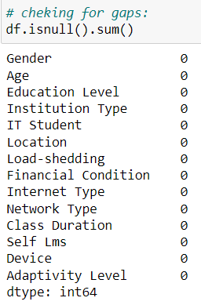

Slide 6
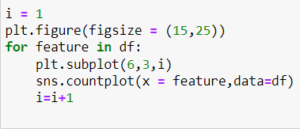
Data Visualisation
Analysis of the data by constructing a general distribution of features by their number:

Slide 7
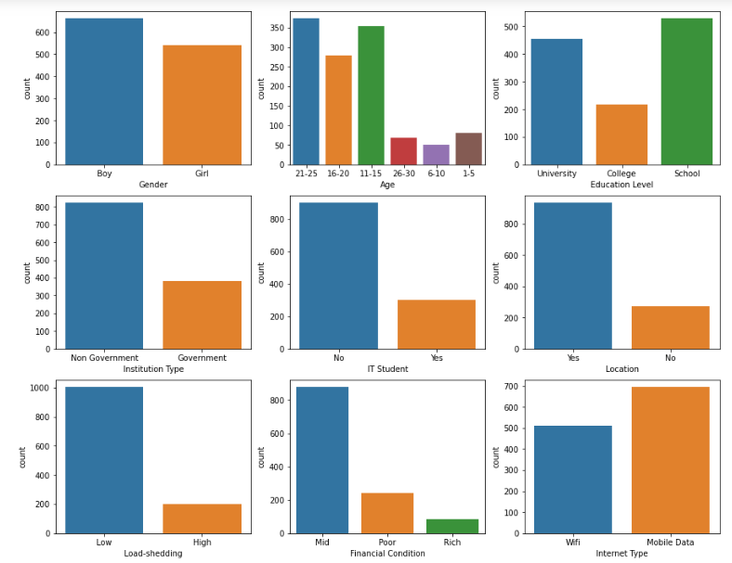

Slide 8
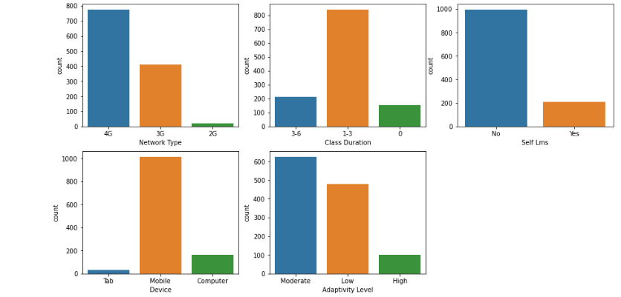

Slide 9
Conclusions from the presented graphs:
Variable study Gender is balanced, applied to the same number of men and women to obtain a relevant result.
most of the subjects correspond to the age of 11–25 years, this is the age when we can confidently talk about sustainable adaptation to learning.
values ​​are contributed by the level of education indicates that most of the subjects have only a school education. These data correlate with a certain schedule, where most of the subjects are in the age range from 7 to 20 years. *existing education services are provided by non-private institutions. This is due to the development of the education market.
it should also be noted that most of the commercials are sold on the phone through the 4G network, which shows that people get education in any place convenient for them.
It should be noted that some of the online courses are not assimilated by students.

Slide 10
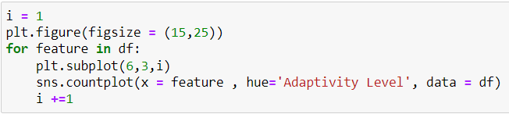
Analysis of the distribution of the number of students depending on the level of their adaptation:

Slide 11
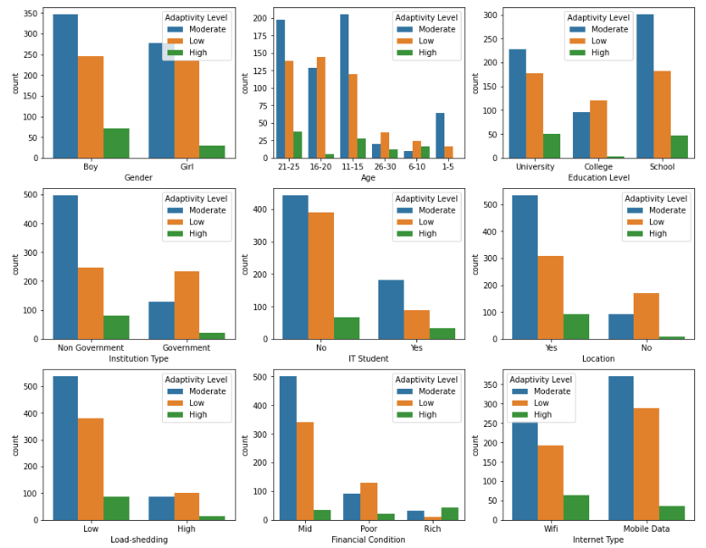

Slide 12
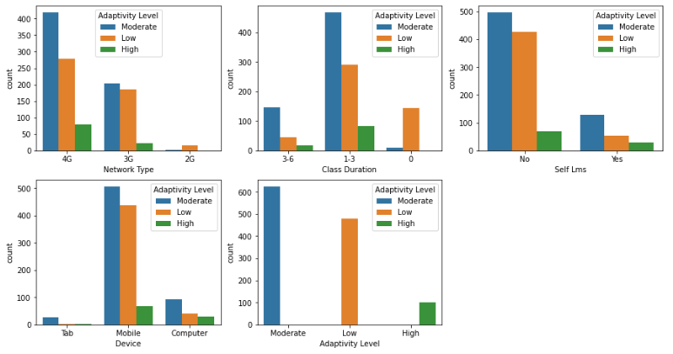

Slide 13
Conclusions from the obtained distributions:
*Men are easier to adapt to new knowledge, the level of poor
adaptation between men and women is approximately the same
*The best adaptation is shown at the age of 21-25, and 11-15, the worst
- after 26 years and in the interval from 16 to 20 years. Worse adaptation
to new knowledge can be explained by social and physiological factors.
*It should also be noted that the best digestibility of the material is
observed in the middle class.
*High adaptation to the material is also noted among urban residents,
this is due to social and economic factors.
*The level of adaptation to new knowledge also depends on the quality
of the Internet.

Slide 14
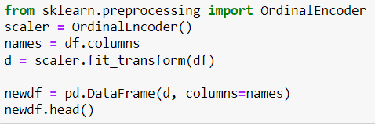
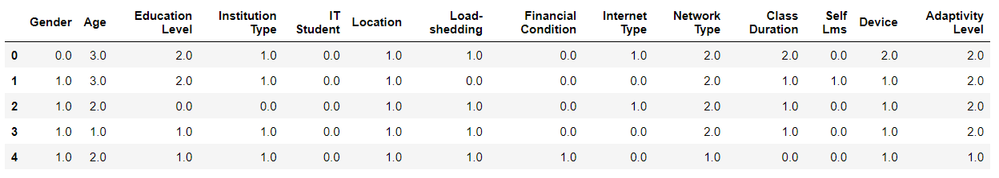
Machine Learning
Encode variables OrdinalEncoder():

Slide 15
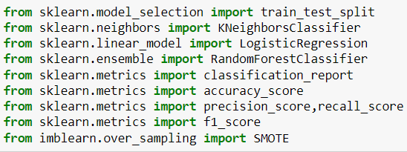
ML Models
*Importing necessary libraries from their corresponding
Modules:

Slide 16
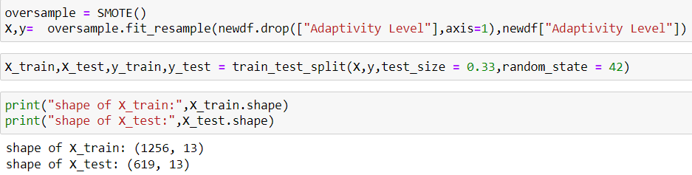
Split Data:
*Split data into train and test set.

Slide 17
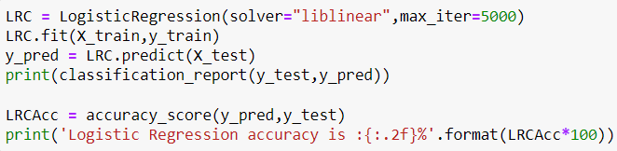
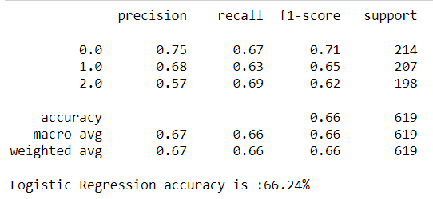
Logistic Regression:
Logistic regression algorithm gives the data an accuracy of 66.24%

Slide 18
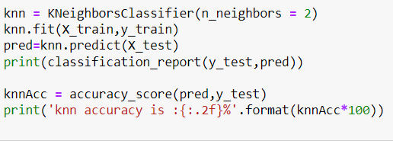
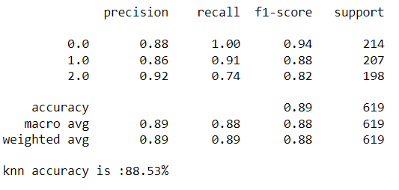
K Nearest Neighbors Classifier:
Knn has an accuracy of 88.53%

Slide 19
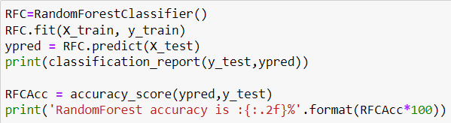
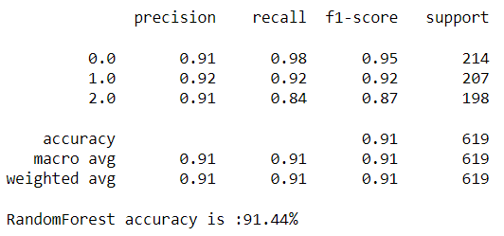
Random Forest Classifier:
Random forest has an accuracy of 91.44%.

Slide 20
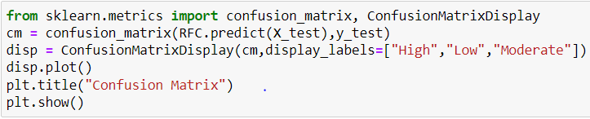
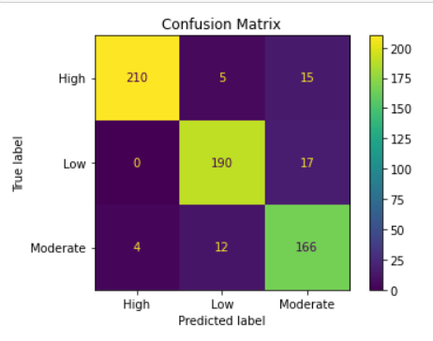
Evaluation matrix
Confusion matrix:

Slide 21
Conclusion
1.Logistic regression has an accuracy of 66.24%.
2.Knn classifier has an accuracy of 88.53%.
3.Random forest classifier has an accuracy of 91.44%.
4.Since random forest classifier has high accuracy we choose random forest
as the model for this dataset.

Slide 22


